Slide 1
Introduction to the Relational Model
7 November 2018

Slide 2
Entities
Something that can exist independently and that can be identified uniquely.
A real world object such as a car or an employee.
Can be thought of as nouns that come up during the problem description.

Slide 3
Attributes
Properties of entities are called attributes.
Attributes represent a subgroup of information of the object represented by the entity.
Attributes define the individual instances and help to differentiate between each instance by describing their characteristic.

Slide 4

Relations
https://thornleyfallis.com/public-relations/
9

Slide 5
Relational Model
SID | Name | Major | GPA
546007 | Susan | CS | 3.80
546100 | Bob | CoE | 3.65
546500 | Bill | CS | 3.70
CID | Name
CS 1555 | DB
CS 1530 | SW
CS 1550 | OS
SID | CID | Grade
546007 | CS 1550 | A
546007 | CS 1530 | B+
546100 | CS 1550 | B
Students
Courses
Enrollment
It is the most popular implementation model
Simplest, most uniform data structures, and is the most formal of all data model
Both entity types and relationship types are represented by relations, i.e., tables

Slide 6
Relation Schema
STUDENT
SID | LName | Name | Class | Major
Schema
123 | Smith | John | 3 | CS
395 | Aiken | Mary | 4 | CS
What is the meaning?
A relation schema R specifies
The name of the relation
the attribute names A_{i} of R
the domain D_{i} (data type + format) for each attribute A_{i}
data type is a set of atomic data values:
no attribute is a set-valued (1st Normal Form, 1-NF)
no attribute is composite
format specifies the representation of a data value

Slide 7
Example Table Schema
Schema of STUDENT(SID, Name, Major, GPA)
CREATE TABLE STUDENT
( SID INTEGER,
Name CHAR(20),
Major CHAR(4),
GPA DEC(3, 2)
);

Slide 8
SQLite Data Types
Each value stored in an SQLite database (or manipulated by the database engine) has one of the following storage classes:
NULL. The value is a NULL value.
INTEGER. The value is a signed integer, stored in 1, 2, 3, 4, 6, or 8 bytes depending on the magnitude of the value.
REAL. The value is a floating point value, stored as an 8-byte IEEE floating point number.
TEXT. The value is a text string, stored using the database encoding (UTF-8, UTF- 16BE or UTF-16LE).
BLOB. The value is a blob of data, stored exactly as it was input.

Slide 9
Date and Time in SQLite
SQLite does not have a storage class set aside for storing dates and/or times. Instead, the built-in date and time functions of SQLite are capable of storing dates and times as TEXT, REAL, or INTEGER values:
TEXT as ISO8601 strings ("YYYY-MM-DD HH:MM:SS.SSS").
REAL as Julian day numbers, the number of days since noon in Greenwich on November 24, 4714 B.C. according to the proleptic Gregorian calendar.
INTEGER as Unix Time, the number of seconds since 1970-01-01 00:00:00 UTC.
Applications can chose to store dates and times in any of these formats and freely convert between formats using the built-in functions.

Slide 10
NULL in SQLite
SQLite NULL is the term used to represent a missing value. A NULL value in a table is a value in a field that appears to be blank.
A field with a NULL value is a field with no value. It is very important to understand that a NULL value is different than a zero value or a field that contains spaces.
We’ll come back to this in our demos.

Slide 11

Relational Database Schema
A database schema is a set of relation schemas and a set of integrity constraints
Structural Integrity Constraints
key constraints: uniqueness of keys
entity integrity constraint: no primary key value can be NULL
referential integrity constraint
Notes:
NULL Value…explain!!!

Slide 12
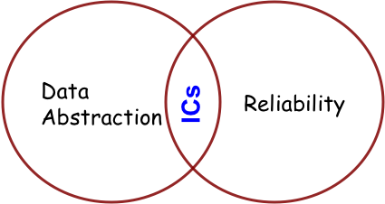
Integrity Constraints (ICs)
IC: condition that must be true for any instance of the database (e.g., domain constraints)
A legal instance of a relation is one that satisfies all specified ICs
ICs are specified when schema is defined
ICs are enforced when tables are modified

Slide 13

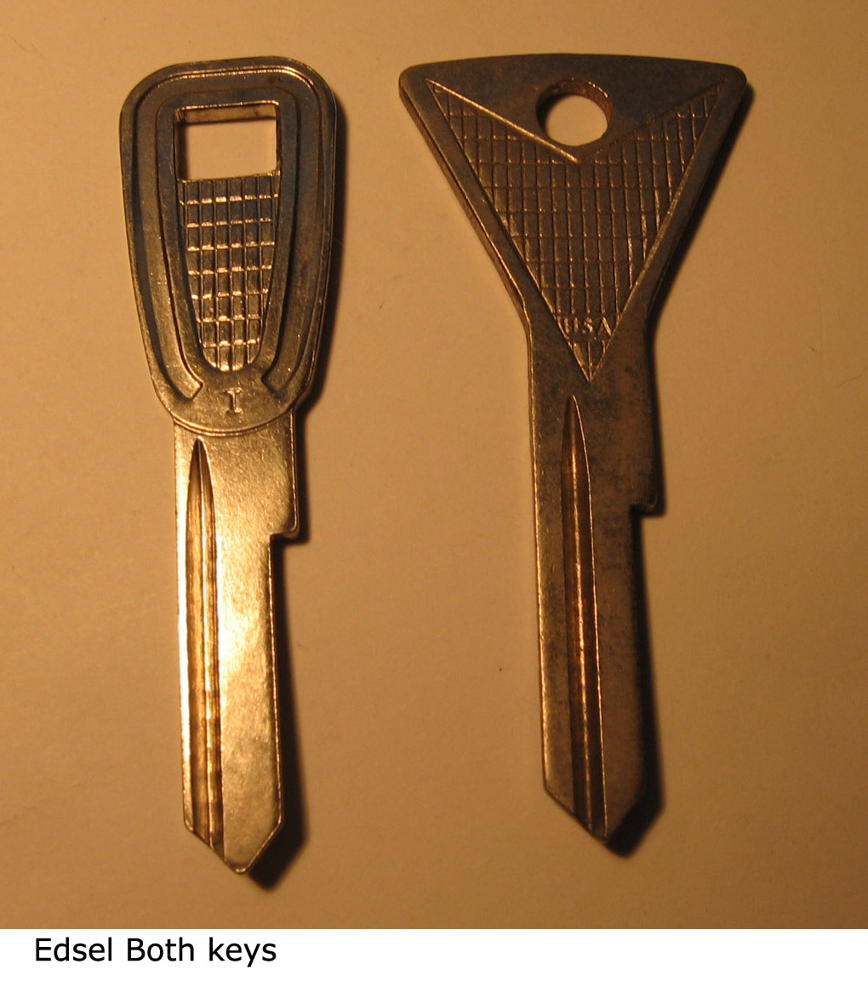
Primary Key Constraint
A set of fields is a key for a relation if :
No two distinct tuples can have same values in all key fields
If there is more than one key for a relation:
Each is called a candidate key
One candidate key is designated as the primary key
Other candidate key(s) are designated as alternative or unique key(s)

Slide 14
Example of Keys
SID | Name | Login | Age | GPA
546007 | Jones | jones@cs | 18 | 3.4
546100 | Smith | smith@ee | 18 | 3.2
546500 | Smith | smith@math | 19 | 3.8
Candidate Keys: SID, and Login
Primary Key: SID
Unique Key: Login

Slide 15
Example Table Schema in SQL
Schema of STUDENT(SID, Login, Name, Major, GPA)
CREATE TABLE STUDENT
( SID INTEGER NOT NULL,
Login CHAR(15),
Name CHAR(20),
Major CHAR(4),
GPA DEC(3,2),
CONSTRAINT STUDENT_PK
PRIMARY KEY (SID),
CONSTRAINT STUDENT_UN
UNIQUE (Login) -- UNIQUE can take NULL values
);
Notes:
UNIQUE can take NULL values without violating entity constraint. Oracle can accept multiple NULLs.

Slide 16
Identifying the Key
What is the key in relation GRADUATE=(SID, Degree, Major, Year) ?
SID | Degree | Major | Year
123 | BS | CS | 1992
123 | MS | CS | 1993
064 | BA | History | 1991
445 | PhD | CS | 1999
Notes:
SID
(SID, Degree) or (SID, Year)
(SID, Degree, Major) or (SID, Major, Year)
(SID, Degree, Major, Year)

Slide 17
Identifying the Key
What is the key in relation GRADUATE=(SID, Degree, Major, Year) ?
SID | Degree | Major | Year
123 | BS | CS | 1992
123 | MS | CS | 1993
064 | BA | History | 1991
445 | PhD | CS | 1999
123 | BS | Math | 1992
Notes:
SID
(SID, Degree) or (SID, Year)
(SID, Degree, Major) or (SID, Major, Year)
(SID, Degree, Major, Year)

Slide 18
Identifying the Key
What is the key in relation GRADUATE=(SID, Degree, Major, Year) ?
SID | Degree | Major | Year
123 | BS | CS | 1992
123 | MS | CS | 1993
064 | BA | History | 1991
445 | PhD | CS | 1999
123 | BS | Math | 1992
123 | MS | Math | 1992
Notes:
SID
(SID, Degree) or (SID, Year)
(SID, Degree, Major) or (SID, Major, Year)
(SID, Degree, Major, Year)

Slide 19

Foreign Keys
Foreign key (FK) in relation R₂ is a set of attributes of R₂ that forms a primary key (PK) of another relation R₁.
Attributes in FK and PK have the same domain
STUDENT
COURSE
SID | Degree | Major | Year
PK
CID | Name
PK
FK
FK
Enrolled
SID . | CID | Grade
PK

Slide 20
Foreign Key & Primary Key
SID | Name | Age
546007 | Peter | 18
546100 | Bob | 19
546500 | Bill | 20
SID | CID | Grade
546007 | CS 1555 | A
546007 | CS 1550 | B+
546500 | CS 1555 | B
CID | Name
CS 1555 | DB
CS 1530 | SW
CS 1550 | OS
Foreign Key
Enrolled
Courses
Primary Key
Students
Foreign key: Set of fields in one relation that is used to “refer” to a tuple in another relation
Must correspond to primary key of the referred relation
E.g. SID is a foreign key referring to Students

Slide 21
Foreign Key Constraints
If foreign key constraints are enforced, referential integrity is achieved
E.g.: Only students can enroll in a class
Only students listed in the “Students” relation should be allowed to enroll for courses
Like a “logical pointer”
There shouldn’t be dangling references
Either valid PK or NULL

Slide 22
Any Attribute can be a Foreign Key
Faculty
Courses
FID | Name | Area
007 | Panos | DB
100 | Daniel | OS
500 | Adriana | AI
CID | Name | Instructor
CS 1555 | DB | 007
CS 1530 | SW | NULL
CS 1550 | OS | 100
Primary Key
Primary Key
Foreign Key
Foreign key: Set of fields in one relation that is used to “refer” to a tuple in another relation
Must correspond to primary key of the referred relation
If not part of a key, it could be NULL

Slide 23
Foreign Keys in SQL
SID | Name | Major | GPA
CID | Name
SID | CID | Grade
Students
Courses
Enrolled
CREATE TABLE Enrolled (
SID CHAR(20), CID CHAR(20), Grade CHAR(2),
CONSTRAINT Enrolled_PK PRIMARY KEY (SID, CID) ,
CONSTRAINT Enrolled_FK_sid
FOREIGN KEY (SID) REFERENCES Students (SID) ,
CONSTRAINT Enrolled_FK_cid
FOREIGN KEY (CID) REFERENCES Courses
);

Slide 24
Now let’s move on to using the relational model with SQLite. Questions?

